Slide 1
systems analysis
Introduction

Slide 2
Topics
Systems analysis definition
Course objective
Why study systems analysis?
Jobs that use systems analysis skills
Software engineering activities
Types of software requirements
Software engineering methodologies
Agile development, user stories, user personas

Slide 3
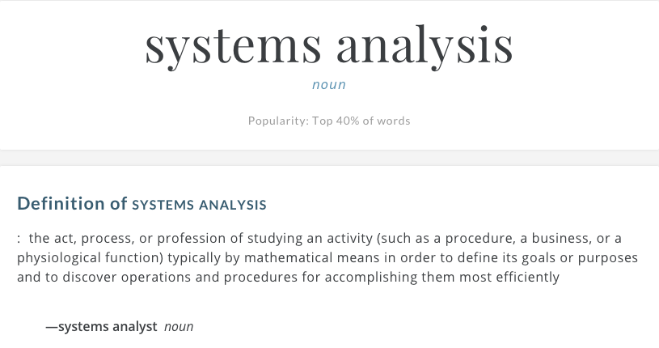

Systems Analysis Defined

Slide 4

SOU Vision
Southern Oregon University will become an inclusive, sustainable university for the future that guides all learners to develop the knowledge, capacities, and audacity to innovate boldly and create lives of purpose.

Slide 5

Course Objective
The overarching goal of this course is for you to learn about the entirety of the software development process, from developing a Vision and Scope document through final testing.
You will apply your knowledge to a real-world project in your capstone project, to be conducted Winter and Spring quarters, 2018.

Slide 6
Why Study Systems Analysis?
Measure twice. Cut once.
Think before you act.
Do it right!
Right product for the clients that is validated to meet the client’s needs
Right software that is verified to conform to a specified design, satisfies a stated set of requirements, and does not have defects
Right project management with enough process to organize the work, but not so much process that it gets in the way

Slide 7
Job Titles
With systems analysis skills you can become a:
Systems analyst
Software engineer
Programmer
Software product manager
Product owner
Scrum master
Project manager
Network engineer
Business analyst

Slide 8
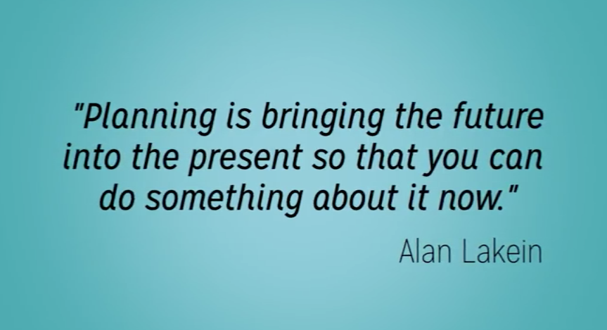
A Goal Without a Plan Is Just a Wish
Notes:
Alan Lakein is a well-known author on personal time management, including “How to Get Control of Your Time and Your Life” which has sold over 3 million copies.

Slide 9
Defining Project Success
On-time delivery
Completed within budget
Delivered with all features complete
No creeping user requirements
No gold-plating
Few post-release bugs
Minimal support needed after a release
Good customer ratings of product
Lots of revenue generated
The client is happy

Slide 10
Risks of Not Using Systems Analysis
The project’s business objectives, vision, and scope never get clearly defined
Developers encounter ambiguities and missing information when coding, so they guess
Developers and stakeholders focus on user interface displays, not on what users really need to do
External interfaces are not worked out in advance
Customers are unhappy with the end result

Slide 11
SOFTWARE ENGINEERING ACTIVITIES
Design and Implementation
Create Process
Set Standards
Manage Risks
Perform Estimations
Make Measurements
Improve Process
Specification
Identify Ideas or Needs
Elicit Requirements
Express Requirements
Prioritize Requirements
Validate Requirements
Manage Requirements
Design Architecture
Design Databases
Design Interfaces
Document
Write Code
Integrate Functionality
Develop Test Procedures
Create Tests
Execute Tests
Report Test Results
Conduct Client Demos
Conduct Project Retrospective
Project Management
Allocate Resources
Verification and Validation
Analyze Requirements

Slide 12
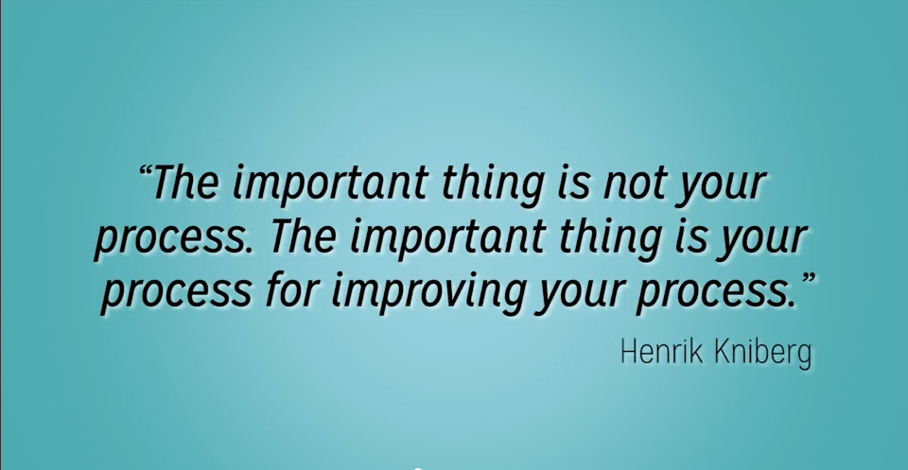
There’s Always Room for Improvement
Notes:
Henrik Kniberg is a coach and consultant at Crisp. Henrik's background is a mix of development and management, and his passion is applying Lean and Agile principles to help debug, optimize, and refactor companies. Henrik is the author of “Scrum and XP from the Trenches” and “Kanban & Scrum, making the most of both”.

Slide 13
Types of Software Requirements
Requirement Type | Definition
Business | A high-level business objective, a reason why the software is being developed
User | A task that a specific class of users must be able to perform with the software, or a desired product attribute for a class of users; helps specify who the product is being developed for
Functional | A description of a behavior that a system will exhibit under specific conditions, what the software will do
Non-Functional | A description of a property or characteristic that a system must exhibit, how well the software will perform

Slide 14
Software Engineering Methodologies
Refer to University of Alberta Course Notes for more details
Linear Models
Agile Models
Other Agile-Related Models
Waterfall
V-Model
Sawtooth Model
Scrum
Extreme Programming
Lean Software Development
Kanban

Slide 15
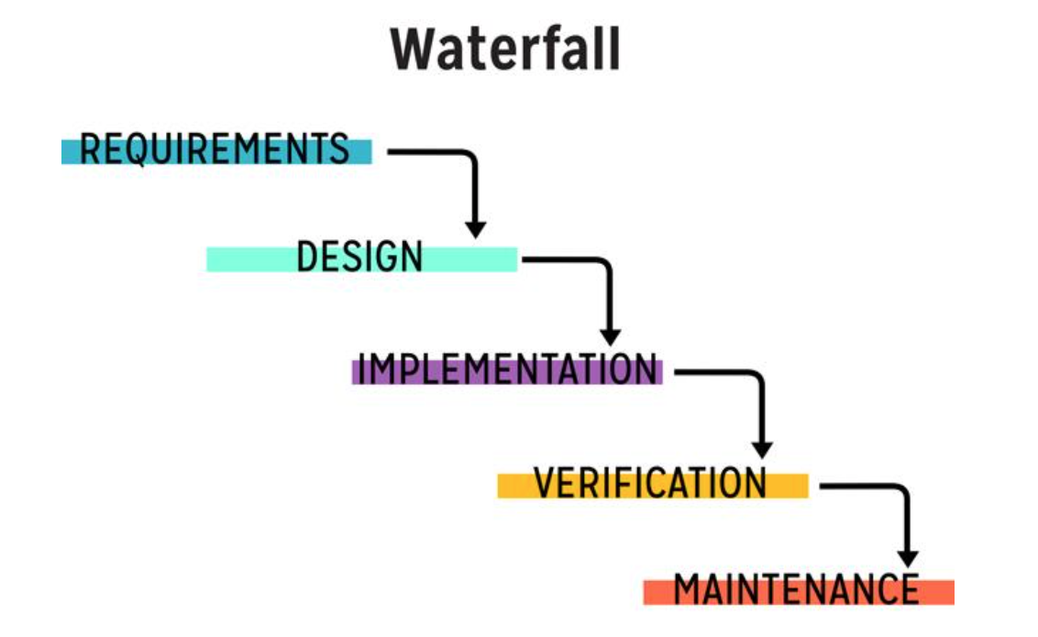
Waterfall

Slide 16
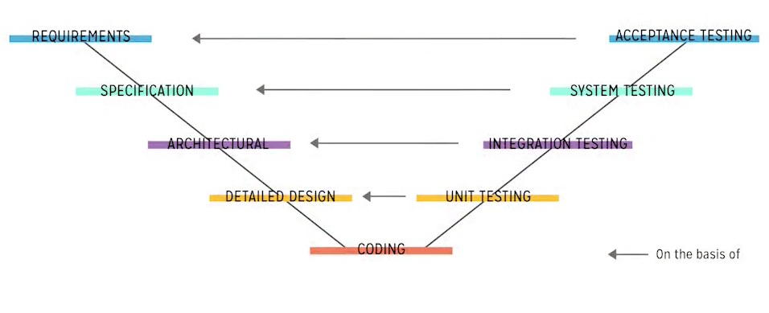
V-Model

Slide 17
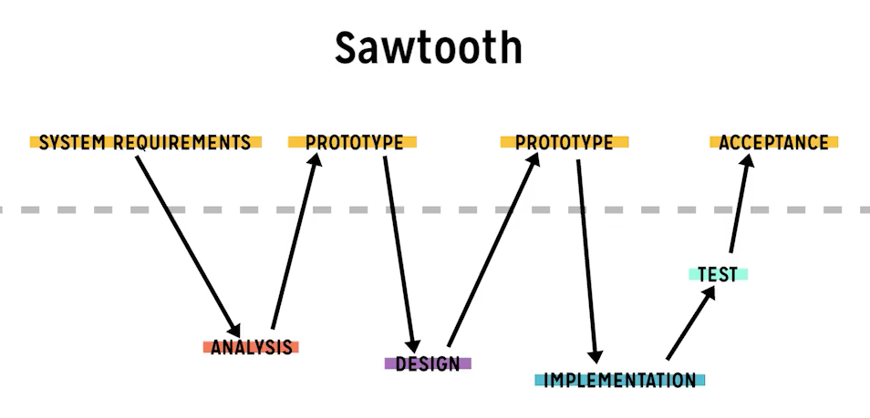
Sawtooth Model

Slide 18
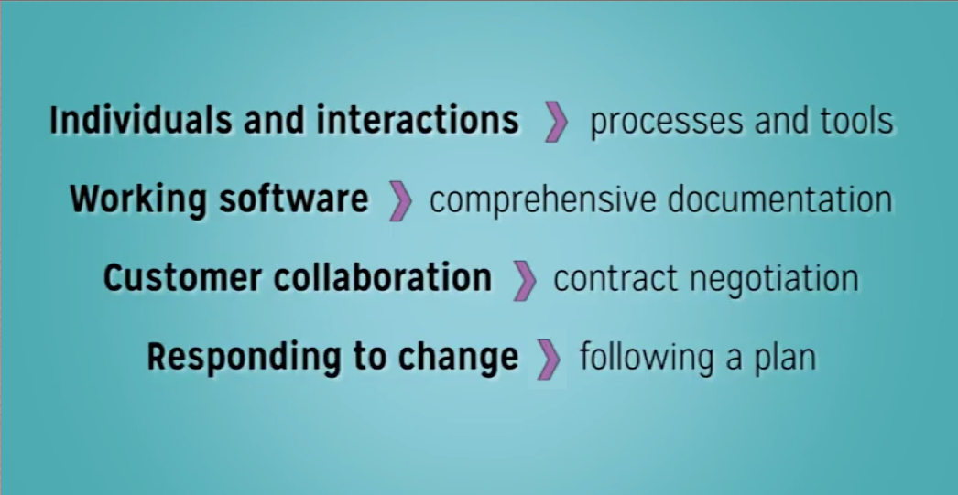
Agile Values
More on this later in the class!

Slide 19
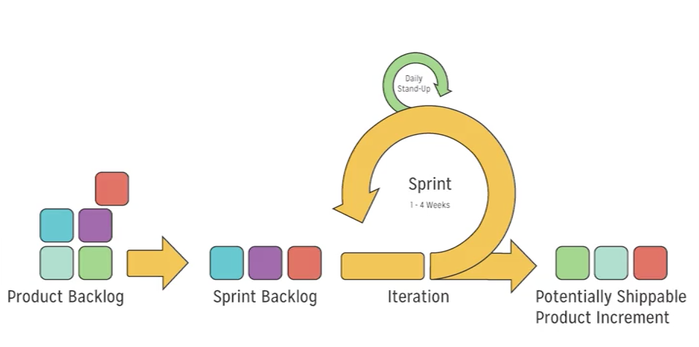
Scrum Sprint

Slide 20
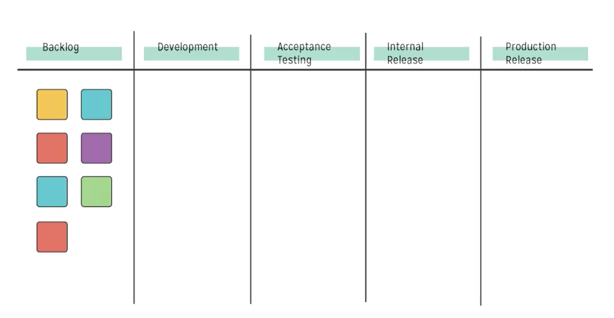
Kanban Board

Slide 21
Agile User Stories
User stories have a specific format:
As a [persona],
I want to [do something],
so that I can [realize a reward]
Examples:
As Helen the HR Manager, I want to screen an engineering candidate, so I know their skills profile.
As a customer, I want to withdraw cash from an ATM, so that I don't have to wait in line at the bank.

Slide 22



Agile User Personas
A description of a hypothetical generic person who serves as a stand-in for a group of users who have similar characteristics and needs
Personas help you understand the requirements and to design the user experience to best meet the needs of specific user communities

Slide 23



Agile User Personas
What makes them tick?
What makes them mad?
What do they think, see, feel, do?
What do they want to do, and why?

Slide 24
Summary
In this module, we talked about:
The definition and importance of systems analysis
Without a plan, it’s just an idea!
Software engineering activities
Project management, specification, design and implementation, verification and validation
Types of software requirements
Business, user, functional, non-functional, external interface
Specifying requirements
Eliciting, analyzing, expressing, prioritizing, validating, and managing requirements
Software engineering methodologies
Agile user stories, user personas

